Slide 1


CMR ENGINEERING COLLEGE
(UGC AUTONOMOUS)
(Accredited by NBA,Approved by AICTE NEW DELHI, Affiliated to JNTU, Hyderabad)
Kandlakoya, Medchal Road, Hyderabad-501 401.
Department of Computer Science & Engineering
Mini Project
On
A ROBUST APPROACH FOR EFFECTIVE SPAM DETECTION USING SUPERVISED LEARNING.
Internal Guide:- Mrs. B. Sri Priya, Assistant Professor,
Dept. of CSE.
By
T. Rohith Reddy
M. Varsha
B. Bala Bhaskar
: (208R1A05H5)
: (208R1A05F6)
: (208R1A05C7)
A.Y 2023-2024

Slide 2
Table of Contents
Abstract
Introduction
Literature Survey
Existing System
Drawbacks of Existing system
Proposed System
Advantages of Proposed System
Software & Hardware Requirements
System Design
UML Diagrams
Testing Techniques
Conclusion & Refernces

Slide 3
Abstract
In this age of popular instant messaging applications, Short Message Service or SMS has lost relevance and has turned into the forte of service providers, business houses, and different organizations that use this service to target common users for marketing and spamming. A recent trend in spam messaging is the use of content in regional language typed in English, which makes the detection and filtering of such messages more challenging. In this work, an extended version of a standard SMS corpus containing spam and non-spam messages that is extended by the inclusion of labeled text messages in regional languages like Hindi or Bengali typed in English has been used, as gathered from local mobile users. Monte Carlo approach is utilized for learning and classification in a supervised approach, using a set of features and machine learning algorithms commonly used by researchers. The results illustrate how different algorithms perform in addressing the given challenge effectively.

Slide 4
Introduction
Man is a social animal , and the very essence of this socializing nature lies in their ability to effectively communicate. From the cave drawings in early ages to the blazingly fast instant messaging applications prevalent in these times, the need for effective communication has always been a priority in human life.
The basic components of a typical communicational are, the communication medium is used by sender(s) to communicate with the receiver(s). This medium of communication has taken forms over the many decades of human civilization. For instance , cave walls , letters(pages), and the text messages are all different forms of communication medium that man has used.

Slide 5
Literature survey
In the paper titled "A Review of Supervised Machine Learning Algorithms for Spam Detection," the authors provide a comprehensive survey of various supervised machine learning algorithms used for spam detection. The authors evaluate the performance of these algorithms on various datasets and discuss the advantages and disadvantages of each algorithm.
In the paper titled "Robust Spam Detection Using Support Vector Machines," the authors propose a robust spam detection system using support vector machines (SVM). The authors evaluate the performance of the proposed system on several datasets and show that SVM outperforms other machine learning algorithms in terms of accuracy and efficiency.

Slide 6
Literature survey
In the paper titled "A Comparison of Machine Learning Techniques for Spam Email Classification," the authors compare the performance of various machine learning algorithms such as SVM, Naive Bayes, and Decision Tree for spam email classification. The authors evaluate the performance of these algorithms on several datasets and show that SVM outperforms other algorithms in terms of accuracy and efficiency.
In the paper titled "Robust Spam Detection Using Feature Selection and AdaBoost," the authors propose a robust spam detection system using feature selection and AdaBoost. The authors evaluate the performance of the proposed system on several datasets and show that the proposed system outperforms other machine learning algorithms in terms of accuracy and efficiency.

Slide 7
Literature survey
Overall, these literature surveys demonstrate that supervised learning algorithms such as SVM, Naive Bayes, Decision Tree, Random Forest, and AdaBoost are effective for spam detection. The choice of the algorithm depends on the specific characteristics of the dataset and the performance requirements of the application.

Slide 8
Existing System
In 2015, Agarwal used a data corpus and added spam and ham SMS from Indian mobile users to it. They showed how different learning algorithms like SVM and MNB performed on the features extracted from the corpora. Many research works have since used the same corpus and similar features and algorithms for spam detection. Recent works show a shift towards neural network-based algorithms.
In 2017, Suleiman compared MNB, Random Forest, and Deep Learning algorithms using a self-determined set of features and the H2O framework on the same SMS corpus. In 2018, Jain used word embedding features to show that CNN performs better than other machine learning models for detecting spam messages in the same corpus.

Slide 9
Existing System
In 2019, Gupta used a voting ensemble technique on various learning algorithms (MNB, GNB, BNB, and DT) to identify spam using the same corpus. This trend of comparing classifier performance continued in 2020 with Hlouli using MLP, SVM, kNN, and Random Forest algorithms to detect spam and ham using Bag of Words and TF-IDF-based features on the same corpus.GuangJun also compared the performance of kNN, DT, and LR models on the SMS spam corpus in a similar work, although they did not discuss the feature extraction techniques.

Slide 10
Drawbacks of Existing System
The system is not implemented Inverse Document Frequency (IDF).
SMS data is to be finally used by the mathematical model–based supervised learning algorithms. These algorithms fail to deal with textual content in the data and are more comfortable with numeric values

Slide 11
Proposed System
It is observed that in spite of the comparative study of classification performance undertaken by the aforementioned state-of-the-art works, none of them have attempted to determine and establish the robustness of the classification techniques in spam identification. Also, the abundance of spam messages in regional language is largely ignored in such works.
The system introduces the novel context of identifying spam and ham SMS in regional languages that are typed in English, along with the general English corpus of spam and ham by extending it.
The system employes a Monte Carlo approach and ML Classifiers to repeatedly perform classification using different machine learning algorithms on different combinations of spam and ham text from the extended corpus (with k-fold cross-validation for a large value of k = 100) in order to determine the efficiency of baseline learning algorithms in comparison to the CNN-based model.

Slide 12
Advantages of Proposed System
The proposed system is more effective due to presence of many ml classifiers.
The proposed system implemented with an accurate prediction for the corresponding dataset.

Slide 13
Software Requirements
Operating system : Windows 7 Ultimate.
Coding Language : Python.
Front-End : Python.
Back-End : Django-ORM
Designing : Html, css, javascript.
Data Base : MySQL (WAMP Server).

Slide 14
Hardware Requirements
➢ Processor - Pentium –IV
➢ RAM - 4 GB (min)
➢ Hard Disk - 20 GB
➢ Key Board - Standard Windows Keyboard
➢ Mouse - Two or Three Button Mouse
➢ Monitor - SVGA

Slide 15
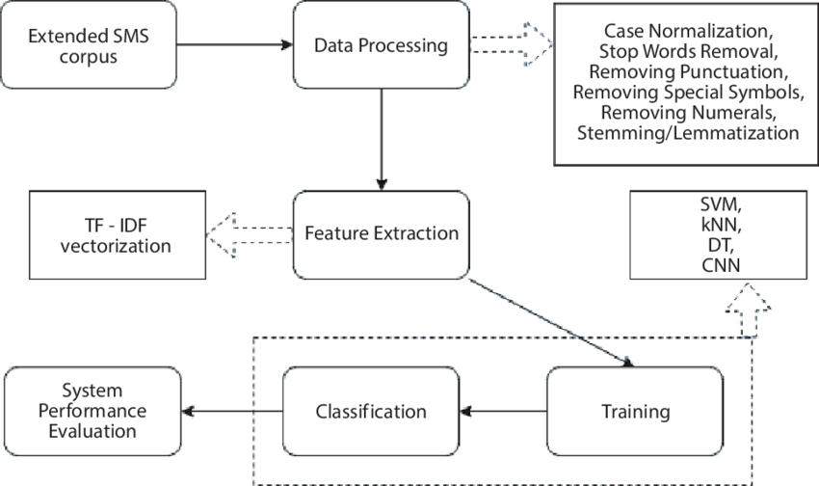
System Design
The current work follows a series of steps as illustrated in Figure 5.2. The corresponding discussions are provided in the following sections.
The SMS corpus with added Indian context, described in Section 6.1, is initially processed in a series of operations as discussed in Section 6.2. The processed text corpus is then vectorized and the TF-IDF vector is determined for the corpora as its feature. This procedure is illustrated in

Slide 16
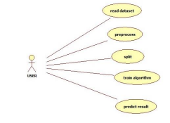
UML DIAGRAMS
USE CASE DIAGRAM

Slide 17
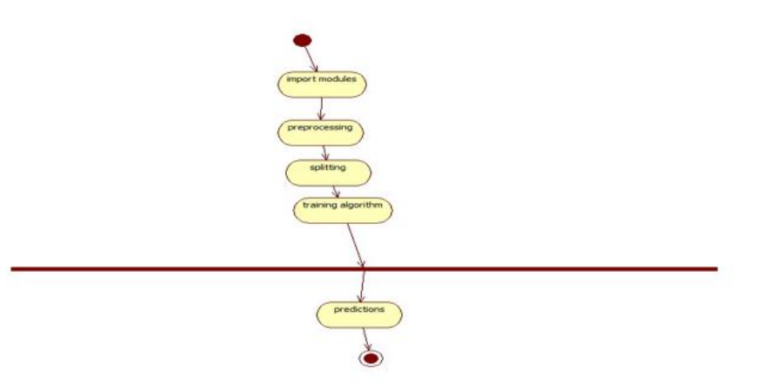
ACTIVITY DIAGRAM

Slide 18
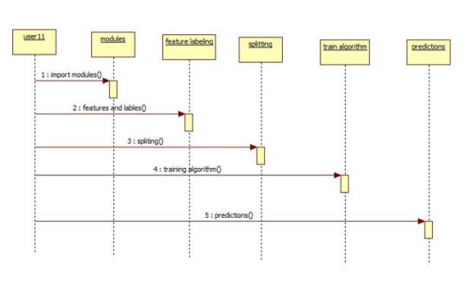
SEQUENCE DIAGRAM

Slide 19
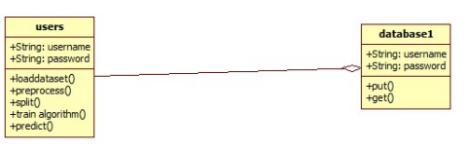
CLASS DIAGRAM

Slide 20
Testing Techniques
Unit testing
Unit testing involves the design of test cases that validate that the internal program logic is functioning properly, and that program inputs produce valid outputs. All decision branches and internal code flow should be validated. It is the testing of individual software units of the application .it is done after the completion of an individual unit before integration. This is a structural testing, that relies on knowledge of its construction and is invasive. Unit tests perform basic tests at component level and test a specific business process, application, and/or system configuration. Unit tests ensure that each unique path of a business process performs accurately to the documented specifications and contains clearly defined inputs and expected results.

Slide 21
Integration testing
Integration tests are designed to test integrated software components to determine if they actually run as one program. Testing is event driven and is more concerned with the basic outcome of screens or fields. Integration tests demonstrate that although the components were individually satisfaction, as shown by successfully unit testing, the combination of components is correct and consistent. Integration testing is specifically aimed at exposing the problems that arise from the combination of components.

Slide 22
White Box Testing
White Box Testing is a testing in which in which the software tester has knowledge of the inner workings, structure and language of the software, or at least its purpose. It is purpose. Itis used to test areas that cannot be reached from a black box level.
Black Box Testing
Black Box Testing is testing the software without any knowledge of the inner workings, structure or language of the module being tested. Black box tests, as most other kinds of tests, must be written from a definitive source document, such as specification or requirements document, such as specification or requirements document. It is a testing in which the software under test is treated, as a black box. you cannot “see” into it. The test provides inputs and responds to outputs without considering how the software works

Slide 23
CONCLUSION
Effective spam detection and filtering is a very well visited field of research, and there is a wide variety of feasible solutions that have been proposed. It is obvious from a review of relevant, recent state-of-the-art literature that the most distinct progress is in the use of newer, advanced algorithms that are capable of learning more about the inherent patterns of different spam and ham messages in a text corpus. Such algorithms are mostly based on Neural Networks and variants of Deep Neural Networks, such as CNN and LSTM. In the current work, a spam detection system that takes as input a comprehensive and well tested SMS corpus, which has been extended by including the context of regional messages typed in English, has been designed and evaluated.

Slide 24
REFERNCES
GuangJun, L., Nazir, S., Khan, H.U., Haq, A.U., Spam Detection Approach for Secure Mobile Message Communication Using Machine Learning Algorithms. Secur. Commun. Netw., Hindawi, 2020, 1–6, 2020.
Roy, P.K., Singh, J.P., Banerjee, S., Deep learning to filter SMS spam. Future Gener. Comput. Syst., 102, 524–533, 2020.
Ghourabi, A., Mahmood, M.A., Alzubi, Q.M., A Hybrid CNN-LSTM Model for SMS Spam Detection in Arabic and English Messages. Future Internet, 12, 156, 2020.

Slide 25


